Slide 1
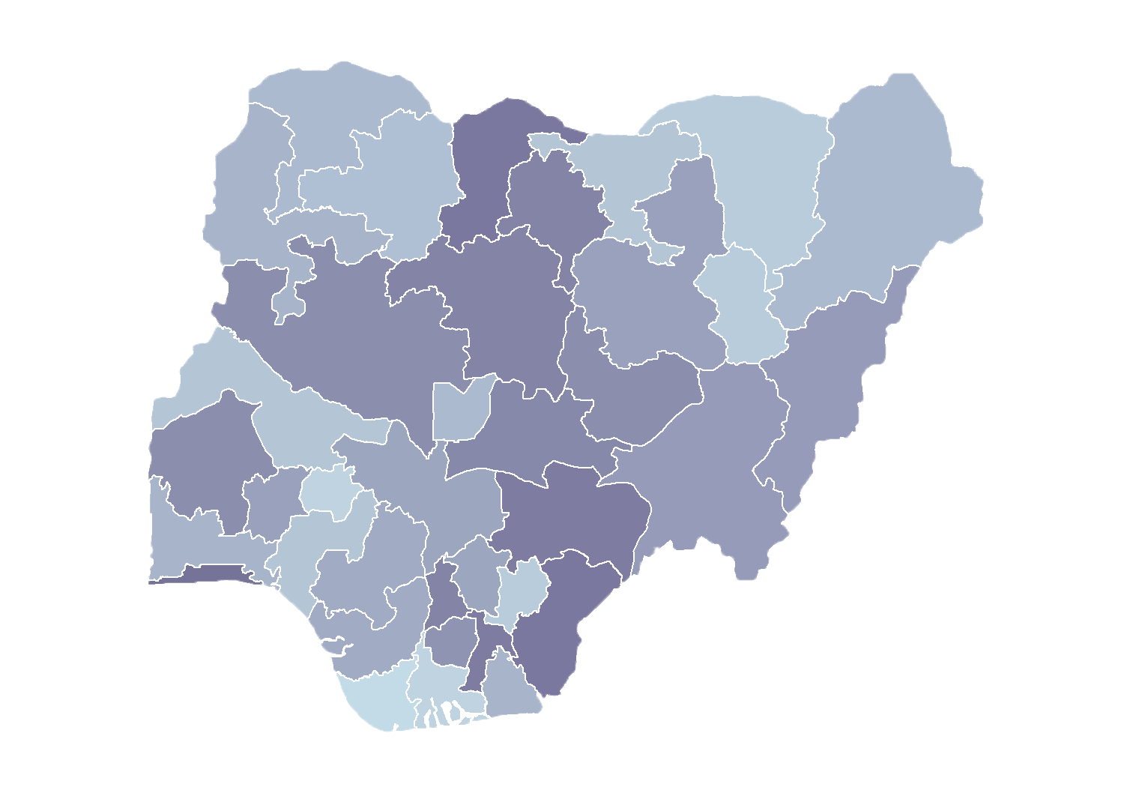
Module 1.5
Next Steps to Improve
Master Facility List Data Quality
Rollout of Health Facility Registry/Master Facility List for States and Local Government Areas in Nigeria
March 2019

Slide 2
Outline
Spatial Quality and Anomalies Diagnosis (SQUAD) tool measures data quality
Data quality scores in Nigeria
Additional master facility list (MFL) data quality issues
Strategies to complete the MFL
Timeline for state MFL implementation
Discussion

Slide 3
SQUAD tool
measures data quality

Slide 4
SQUAD tool
Development
MEASURE Evaluation, funded by the United States Agency for International Development (USAID) and the United States President’s Emergency Plan for AIDS Relief (PEPFAR), created the SQUAD tool to assess data quality issues.
The tool performs a data quality check on data sets, rapidly and automatically looking for anomalies in the data that need to be investigated.
In Nigeria, it is used to assist in development of an action plan to improve data in an MFL.

Slide 5
SQUAD tool
Notes:
Explain what SQUAD stands for
Explain the nature of the SQUAD tool — that it is a global good available to all countries developing a MFL

Slide 6
Six distinct anomalies
may indicate a data quality issue
Missing geocoordinates
Geocoordinates truncated
Duplicate/overlapping coordinates
Duplicate facility names
Site slightly outside local geographic (local government area [LGA]) boundaries
Site significantly outside LGA boundaries
Each anomaly requires investigation!

Slide 7
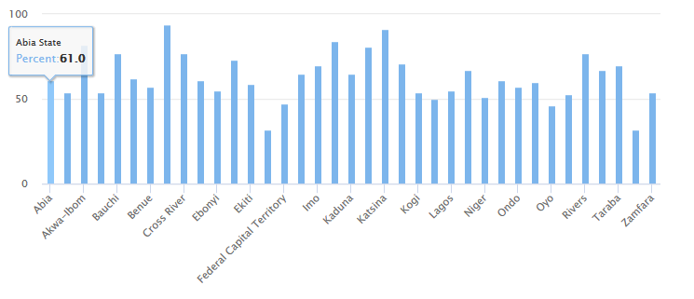
Missing coordinates (1)
By state/December 2018
Q1: Which states have the most complete set of geocoordinates?
Notes:
Q1: Borno State 94% and Katsina 91%
Q2: Yobe State 32%

Slide 8
Coordinates truncated (2)
Missing significant digits
Coordinate | Approximate precision
23.1 | 10 kilometers
23.12 | 1 kilometer
23.123 | 100 meters
23.1234 | 10 meters
23.12345 | 1 meter
Aim to complete coordinates with 5 decimal places
Notes:
The second anomaly is an instance where a coordinate is missing significant digits. The precision of the coordinate is dependent on the number of digits recorded.
There is a paradox with precision, however. There should be enough significant digits included in a coordinate to meet accuracy standards for the database. But, too many digits provide a precision beyond what is really needed (or even technically possible without using survey-grade GPS receivers). Typically, GPS units and GPS-enabled phones and tablets can record a GPS coordinate to six digits, which provides a location precision of roughly 10 centimeters. This level of precision is not necessary when locating a building such as a health facility, where a precision of one meter (five digits after the decimal point) is more than sufficient.
Possible solutions for this anomaly are similar to those for anomaly 1. Review any GPS logs, recapture the location on a future site visit, or use imagery from ArcGIS, Google Earth, or some other source to locate the site.
Note: It’s important to mention that this definition of precision doesn’t account for systematic errors in the GPS signal that may affect the precision of a coordinate. Having a coordinate with six numbers after the decimal point provides a theoretical precision of 10 centimeters. However, GPS signal issues could add error and the actual recorded coordinate could be off from the true location by more than 10 centimeters.

Slide 9
Overlapping coordinates (3)
Two facilities co-located
This anomaly occurs when there are multiple records with identical coordinates.
Notes:
The third anomaly identifies records that have duplicate coordinates.
This anomaly does not necessarily mean there is an error in the data, because in some instances, it may be possible for two sites to be at the same location—for example, in a medical park. For records with this anomaly, the first step is to determine if there are in fact two distinct sites at that location.
If an investigation reveals that there aren’t two sites, then the same steps used to address anomaly 1 and anomaly 2 can be employed: Review any GPS logs, recapture the location, or use imagery.

Slide 10
Duplicate facilities (4)
Two facilities with the same name
Sometimes facilities have the same name.
This situation may be accurate
But it merits investigation
Mercy Clinic
Mercy Clinic
Notes:
Anomaly 4 is the presence of records that contain duplicate facility names.
Once again, this is not necessarily an indication of erroneous data. However, it is an anomaly that merits investigation.
To resolve this anomaly, it is necessary first to determine if there are, in fact, two distinct sites with the same name. This can be done by contacting the site directly to get clarification or by reviewing documents, reports, licensing records, or other sources to determine the site’s official name, which can then be corrected in the database.

Slide 11
Facility slightly outside LGA (5)
but within 2 km
Mercy Clinic’s coordinates show that it is located in the Aba South LGA
1.8 km from the border with the North District
However, the MFL suggests that Mercy Clinic is located in Aba North LGA
Aba North LGA
Aba South LGA
1.8 km
Mercy Clinic
Notes:
If a site is supposed to be in one administrative unit (such as a district) but shows up somewhere else when mapped, that is an error that needs to be resolved. When the site is near (within 2 kilometers) its expected location, there are three potential data issues in play:
The GPS coordinate could be incorrect;
The administrative unit field in the site list could contain incorrect information; or
The GIS boundary file for administrative units could have errors or be inaccurate or out of date.
To address records with this error, using a different GIS boundary file may indicate that the site is where it is expected. If the error is still there after boundary files are changed, then it will be necessary to review the documents associated with the site, use imagery to locate the site, or revisit it and collect a GPS coordinate.

Slide 12
Facility too far outside LGA (6)
by more than 2 km
Mercy Clinic’s coordinates show that it is located in Australia
This is significantly outside of the expected LGA
The coordinates are not anywhere near where they should be.
Notes:
The last type of anomaly is when a site is not located anywhere near where it should be. For instance, the site is in the ocean or in another country or any location more than two kilometers from the expected administrative unit.
There are several possible solutions to address this anomaly:
First, look for obvious issues in the coordinates, such as the X coordinate and the Y coordinate being transposed; or obvious typos, such as a coordinate value in the database that should be 35 degrees being recorded as 53 degrees.
The administrative unit field in the site list could contain incorrect information.
The GIS boundary file for administrative units could have errors or be inaccurate or out of date.
To address records with this error, using a different GIS boundary file may indicate that the site is where it is expected. If the error is still there after boundary files are changed, then it will be necessary to review the documents associated with the site, use imagery to locate the site, or revisit it and collect a GPS coordinate.

Slide 13
Data quality scores
in Nigeria

Slide 14
Data quality score
Percentage of facilities without anomalies
As of December 2018, there were 39,550 hospitals and clinics in the HFR:
(51%) had one or more anomalies
(37%) did not have a coordinate
(7%) contained duplicate names
A facility record without any anomaly is considered to have good data quality.
Notes:
Q1: 49%
Q2: Abia = 59% (above national average)
Q2: Niger = 63% (above national average)

Slide 15
Data quality score
Percentage of facilities without anomalies

Slide 16
Data quality score – Abia
Percentage of facilities without anomalies

Slide 17
Data quality score – Abia

Slide 18
Other MFL data quality issues
not addressed by the SQUAD tool
Missing signature domain
Identification fields
Contact information
Facility classification field, etc.
2. Missing service domain
Service and operational field
Human resource fields

Slide 19
Strategies to
complete the MFL

Slide 20
How to improve data quality?
Measured by SQUAD tool
Missing geocoordinate
Geocoordinates truncated
Overlapping coordinates
Duplicate facility names
Facility slightly outside LGA
Facility too far outside LGA
Ideally, some cleaning can occur before conducting field visits.

Slide 21
Dual objectives
of field visits for data collection
Cleaning and completion of geocoordinate data
Will improve data quality score (SQUAD)
Will de-duplicate and improve count of facilities
Collection of missing service domain data
Can be measured by internal completeness*
Will improve utility of MFL for facility management
Ideally, visits to the field would accomplish the objectives of improving the data quality.
Notes:
The cleaning of geocoordinate data and the collection of missing geocoordinate data will have a direct impact on your data quality score as measured by the SQUAD tool.
As a result, facilities will be de-duplicated, and the overall MFL will become more credible. We will know definitively how many facilities there are in Nigeria and where they are located!
At the same time, we must think about collecting missing service domain data. We will learn more about what data elements are included and their definitions in the coming days
We will develop a score to track the extent to which facility records have been filled out completely so that we can track progress.
This will lead to the increased utility of the MFL for facility management (for example, we will know how many doctors vs. nurses are assigned, etc.).
Be sure that field visits accomplish the dual mandate of collecting both pieces of missing data geocoordinates AND service delivery information.

Slide 22
Timeline for state
MFL/HFR implementation

Slide 23
State timeline
Phase A
Training
Data
Collection
Phase B
Training
Understand the basic principles of the MFL.
Learn how facility updates are approved within the HFR.
Conduct a desk review.
Leverage field visits to collect missing geo-coordinates.
Collect service delivery data.
Assign user roles based on approval responsibilities.
Enter data in the HFR.
Visualize maps for facility management.
Facility updates are approved within HFR and pushed to the DHIS 2
(3 days)
(4 weeks)
(3 days)
MFL fully implemented at the state level!

Slide 24
Discussion

